Slide 1
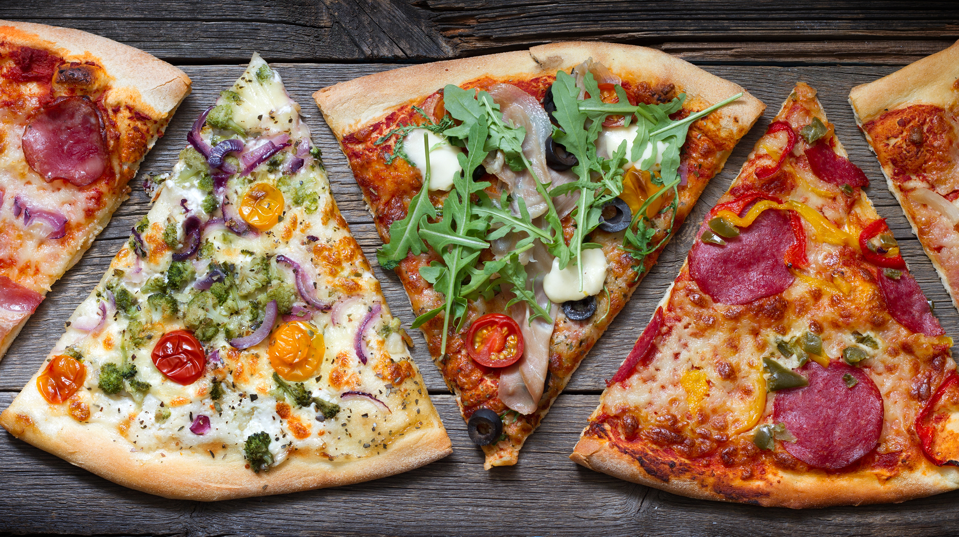
Dominos - Predictive Purchase Order System

Slide 2
Objective
Dominos wants to optimize the process of ordering ingredients by predicting future sales and creating a purchase order. By accurately forecasting sales, Dominos can ensure that it has the right amount of ingredients in stock, minimizing waste and preventing stockouts. This project aims to leverage historical sales data and ingredient information to develop a predictive model and generate an efficient purchase order system.

Slide 3
Approach
Data Processing
Import
Data imported and check for missing and null values in Sales data and ingredient Data.
Missing Value Treatment
Missing values in Name, size and category was treated by lookup from the same column values. Total price derived from Quantity and unit price. And dropping null values.
Feature Engineering
New features created from Order date, like Week of the year, Day of the week, time of order and is Holiday.

Slide 4
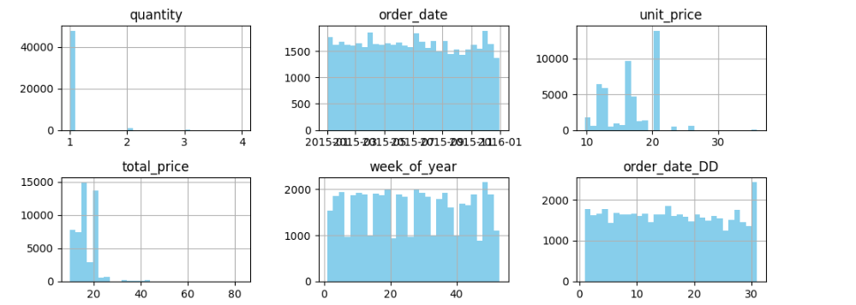
Approach
Exploratory Data Analysis (EDA)

Slide 5
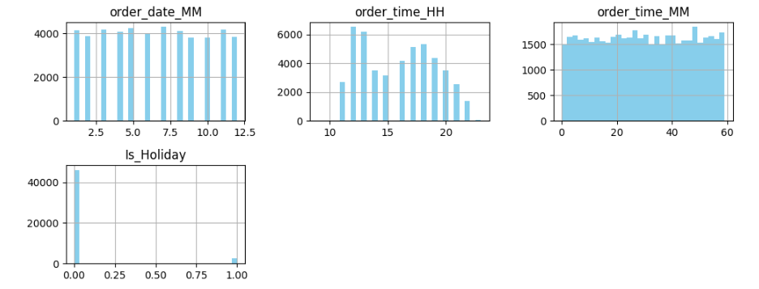
Approach
Exploratory Data Analysis (EDA)

Slide 6
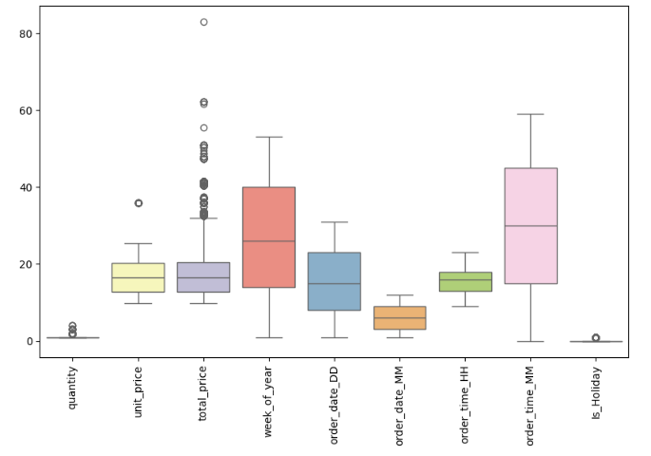
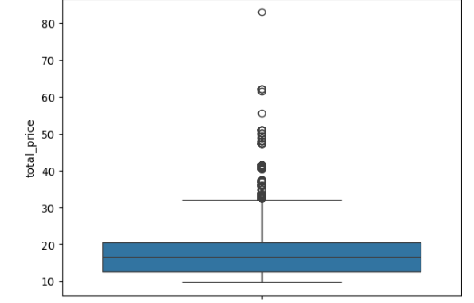
Approach
Exploratory Data Analysis (EDA)

Slide 7
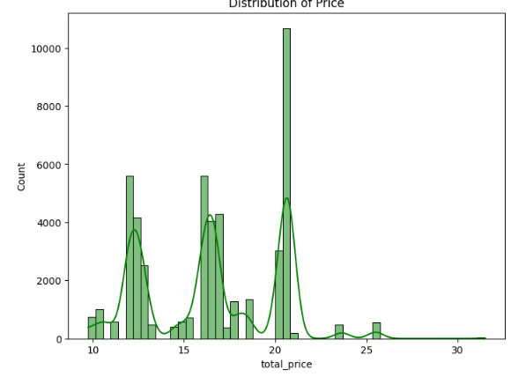
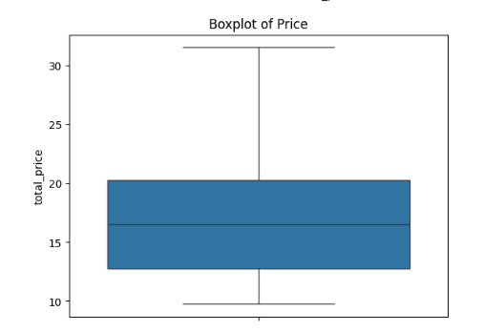
Approach
Exploratory Data Analysis (EDA) – Outliers Removed

Slide 8
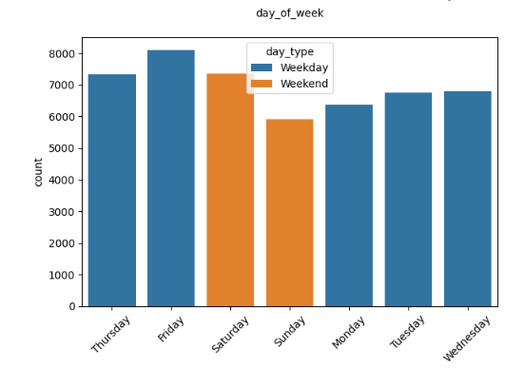
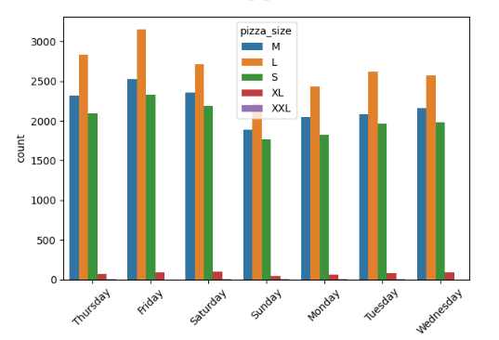
Approach
Exploratory Data Analysis (EDA)

Slide 9
Approach
Model Development
Choose Feature columns as order_date, pizza_name_id, pizza_name, pizza_size,day_of_week, day_type week_of_year, week_label,order_date_DD, order_date_MM,quantity.
Model Selection
1.ARIMA Model
2.SARIMAX Model

Slide 10

Approach
Model Training
1.Arima Model
MAE and MSE giving model performing well. Check with SARIMAX Model as well

Slide 11

Approach
Model Training
2. SARIMAX Model
Compared to ARIMA Model we get the good improvement in SARIMAX

Slide 12
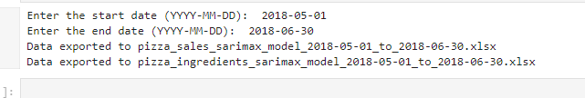
Approach
Sales Prediction
Since Model trained using trained model start predicting the Sales for a given input and out put Dates.
Users Input: From date and To Date

Slide 13
Approach
Sales Prediction
No of Pizza’s for a day and ingredients required for a requested time frame will be exported as a excel and store in place.

Slide 14
Thanks!

